Slide 1
Simulating Alternations for Temporary Crops
GEOG 360-01-F23
Adeline Akansobe, Yu-Yun Ruan, Clio Bate, & Esha Bharadwaj
December 6th, 2023

Slide 2
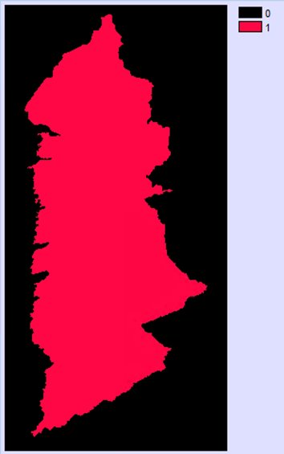
Objectives and Intended Product
Research Objective: Simulate gross gains and losses and attempt to simulate alternations for the time interval of 2000 to 2020 using temporary crop data from Bahia, Brazil using TerrSet's Land Change Modeler(LCM).
Our intended final product is a report on the software issues we encountered during our analysis which include striping and masking errors, to Tammy Woodard of Clark Labs.
Our study area: Bahia, Brazil
Notes:
Esha
We were curious to know how sub models in Land Change Modeler will simulate this change, and are particularly interested in looking at the alternation

Slide 3
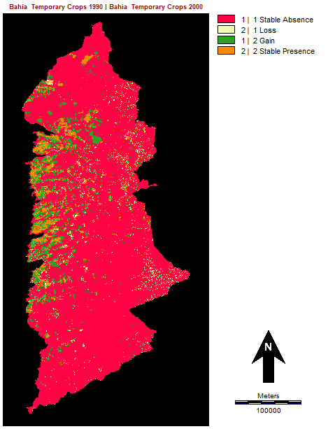
Data and Methodology
All data is at a resolution of 120m.
We used TerrSet's Land Change Modeler to run the analysis using the MLP algorithm, grouped all variables, and included two recalculation stages with soft prediction checked.
We used a calibration interval of 10 years. 1990 and 2000 were used as inputs for the earlier and later land cover images respectively.
The Bahia municipalities were masked to make sure all the simulated change occurs within Bahia.
CrossTab: Temporary Crops 1990 and Temporary Crops 2000

Slide 4
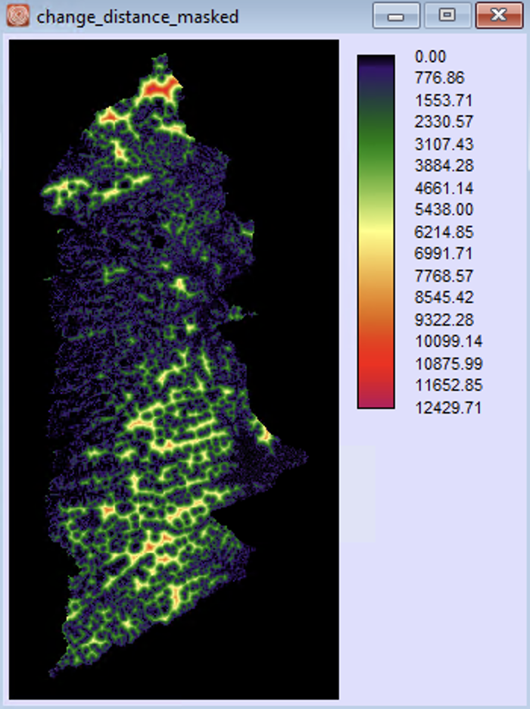
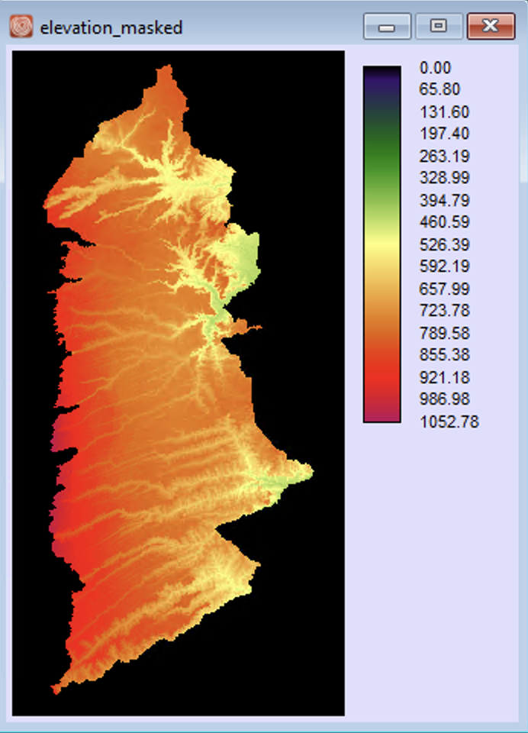
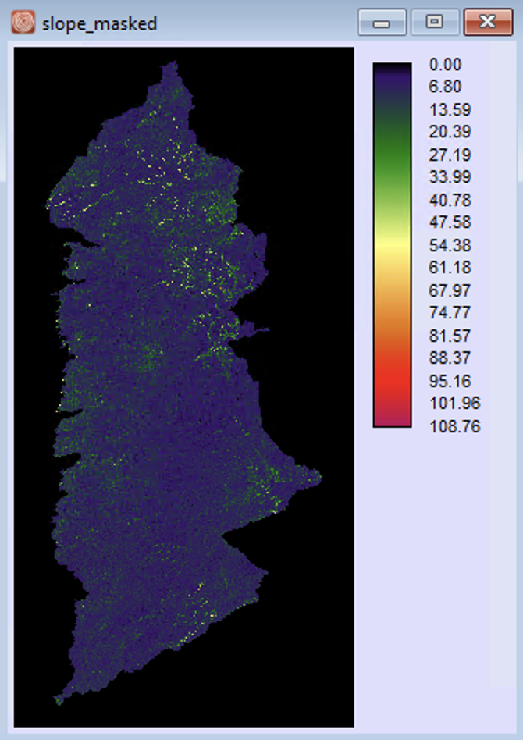
Variables Used

Slide 5
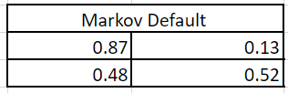
Methodology
The Multi-Layer-Perceptron sub-model in TerrSet was used to run the analysis to create model-simulated images in two stages where the Markov matrix was in the default setting.
The Variables used are:
Distance to Change (DTC), 1990 – dynamic/static variables
Elevation – static variable
Slope – static variable
We simulated five runs using different combinations of the variables:
Run 1: one variable, DTC (Static)
Run 2: two variable, DTC (Static) and Elevation
Run 3: one variable, DTC (Dynamic)
Run 4: two variables, DTC (Dynamic), and Elevation
Run 5: three variables, DTC (Dynamic), Elevation, and Slope
5
Notes:
Esha
Mask: since we are focusing on the Bahia region, we created a mask to make sure all simulated change was within the Bahia region
Using 1990 and 2000 as initial maps (start and end); simulated 2020 (2 stages so 2010 and 2020)

Slide 6
Run1: DTC (static)
One variable

Slide 7
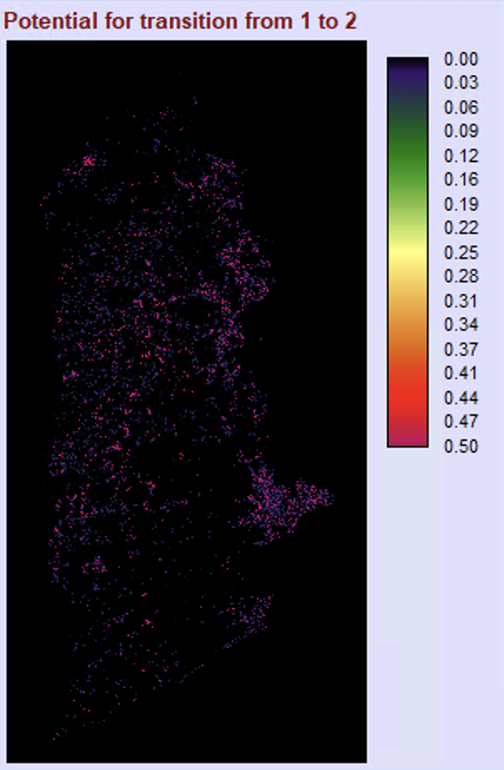
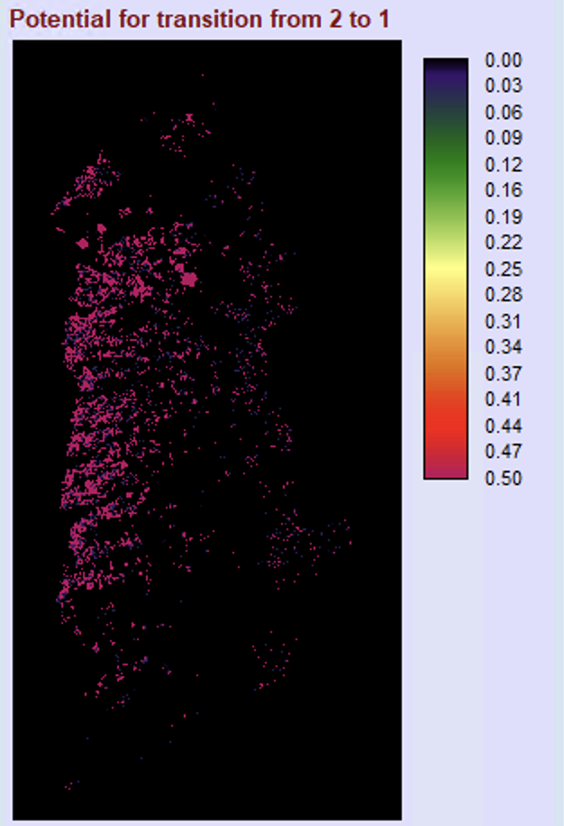
Transition Potential Maps for 2 Stages DTC (Static)

Slide 8
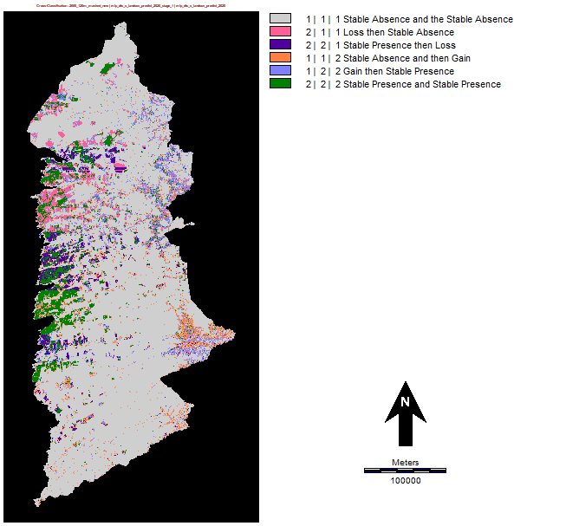
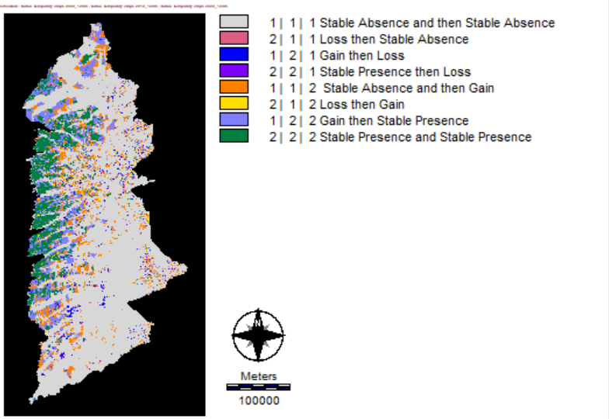
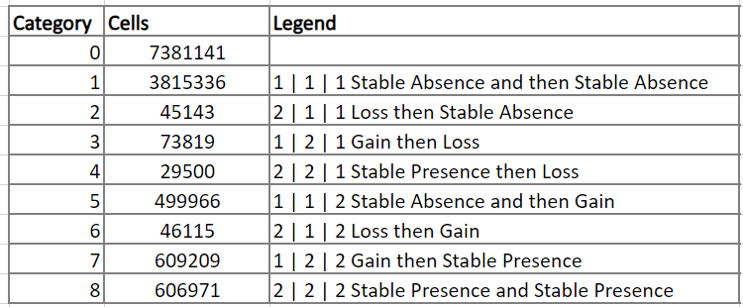
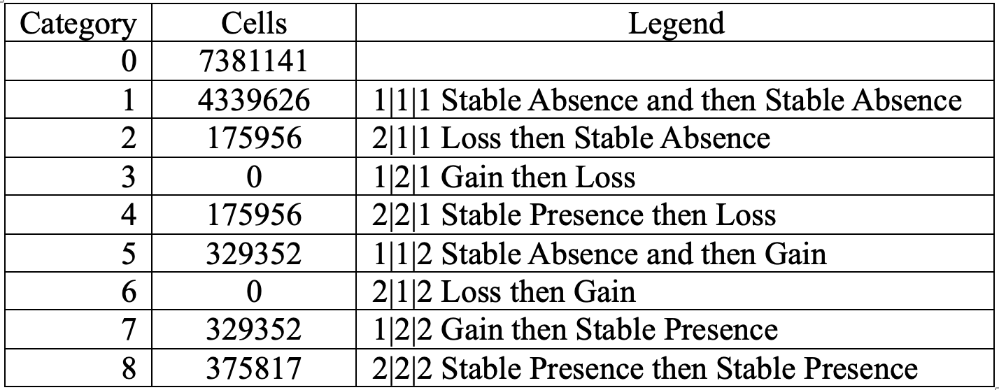
CROSSTAB- DTC (Static)
2000| 2010 Simulation | 2020 Simulation
Reference Change 2000| 2010 | 2020
Loss(2&3) : 351,912
Gain(4&5): 658,704
Loss(2,3,4) : 148,462
Gain (5,6,7): 1,155,290
Absence of Alternation in Simulation:
1 | 2 | 1 Gain then Loss
2 | 1 | 2 Loss then Gain

Slide 9
Run2: DTC (static) and Elevation (static)
Two variables

Slide 10
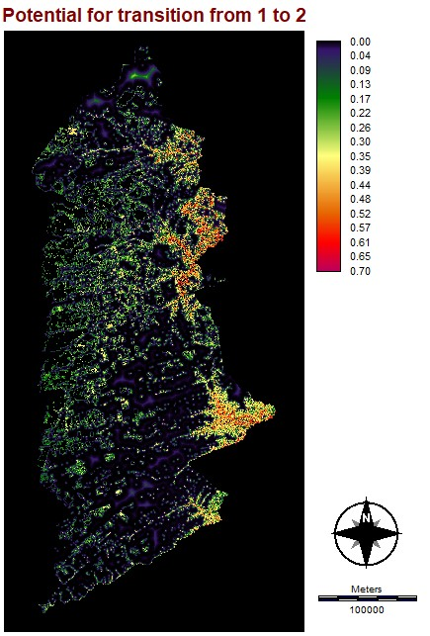
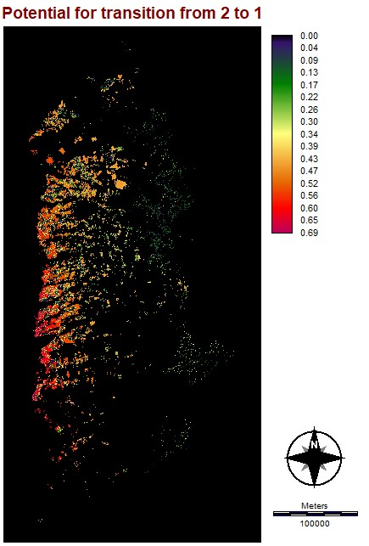
Transition Potential Maps for 2 stages for DTC (static) and elevation (static)

Slide 11
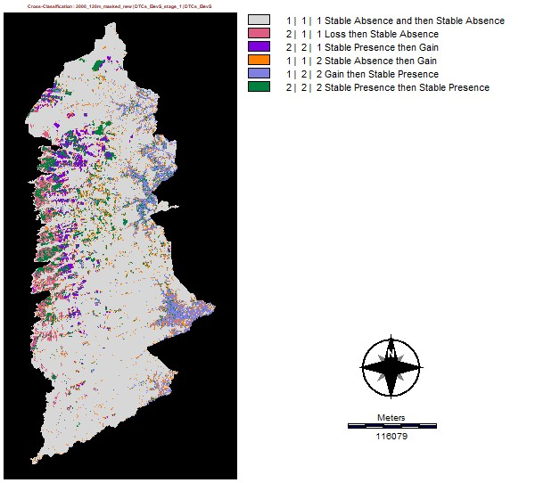
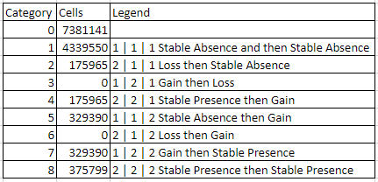
CROSSTAB – Two variables: DTC (static) & elevation
2000| 2010 Simulation | 2020 Simulation
Reference Change 2000| 2010 | 2020
Loss (2,3,4) : 148,462
Gain (5,6,7): 1,155,290
Absence of Alternation in Simulation:
1 | 2 | 1 Gain then Loss
2 | 1 | 2 Loss then Gain
Loss (2,3,4): 351,930
Gain (5,6,7): 658,780

Slide 12
Run3: DTC (dynamic)
One variable
Notes:
Addy

Slide 13
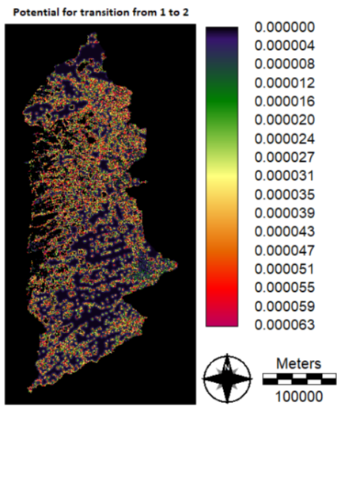
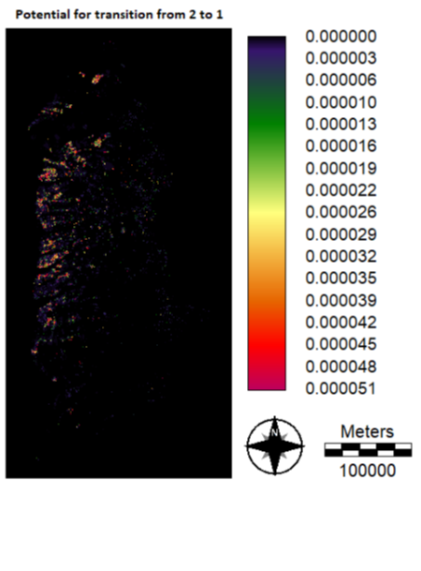
Transition Potential Maps for 2 stages for DTC as Dynamic Variable
Notes:
Clio

Slide 14
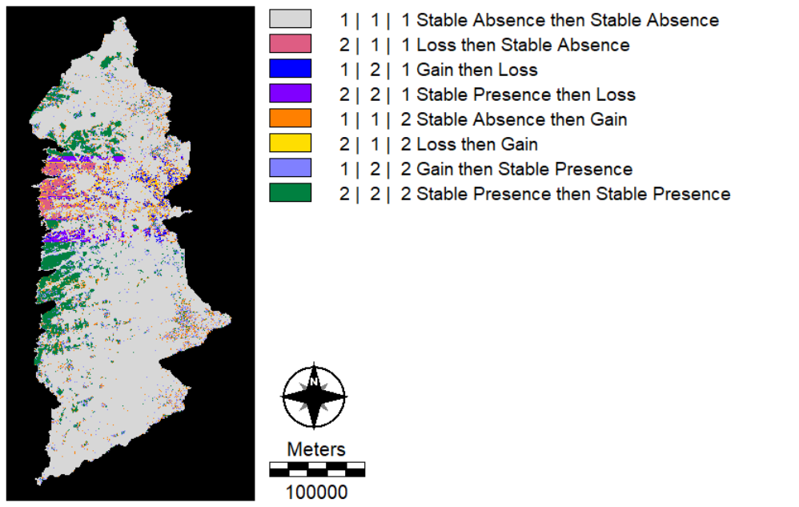
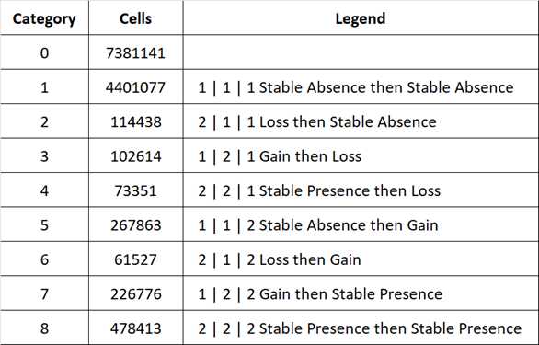
CROSSTAB – DTC (dynamic)
2000 | 2010 Simulation | 2020 Simulation
Reference Change 2000 | 2010 | 2020
All 8 categories are present however, there is noticeable banding in the simulation image- specifically in Loss then Stable Absence(2|1|1) and Gain then Stable Presence (1|2|2)
Loss (3,4,5) : 290,403
Gain (6,7,8) : 556,166
Loss (2,3,4) : 148,462
Gain (5,6,7): 1,155,290
Notes:
Addy

Slide 15
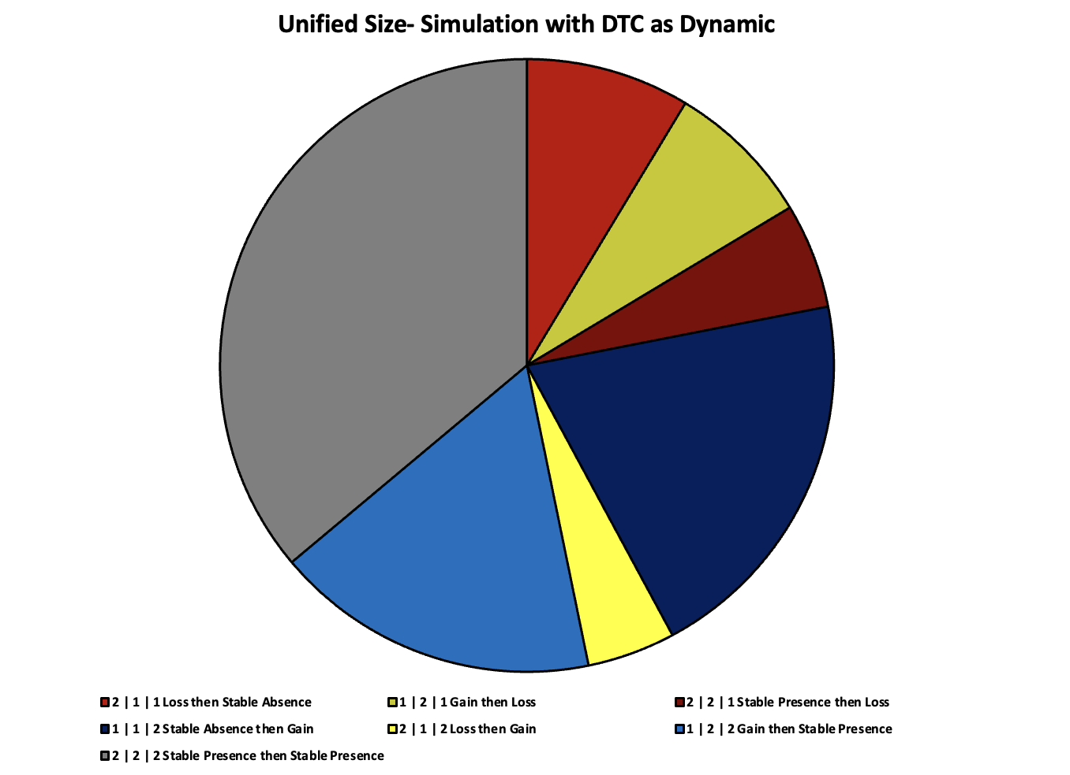
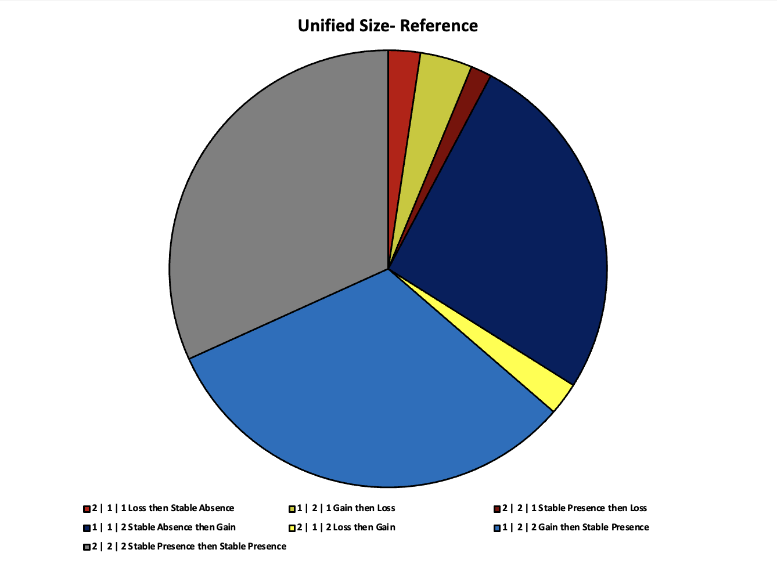
Trajectory of change with DTC as Dynamic (2000-2010-2020)
Unified Size - Simulation
Unified Size - Reference

Slide 16
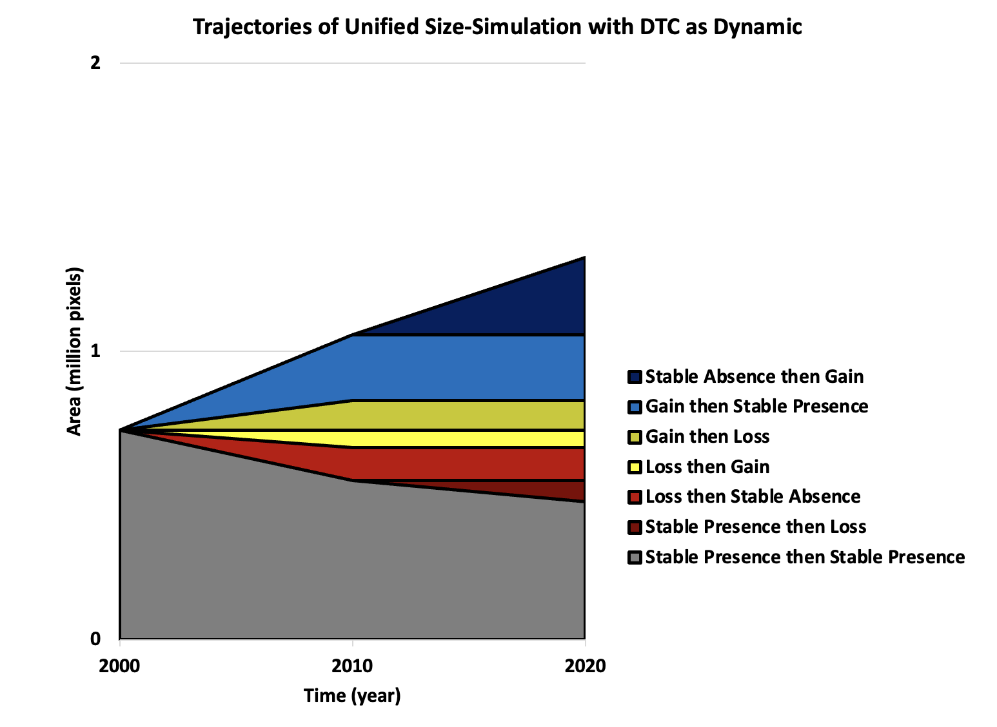
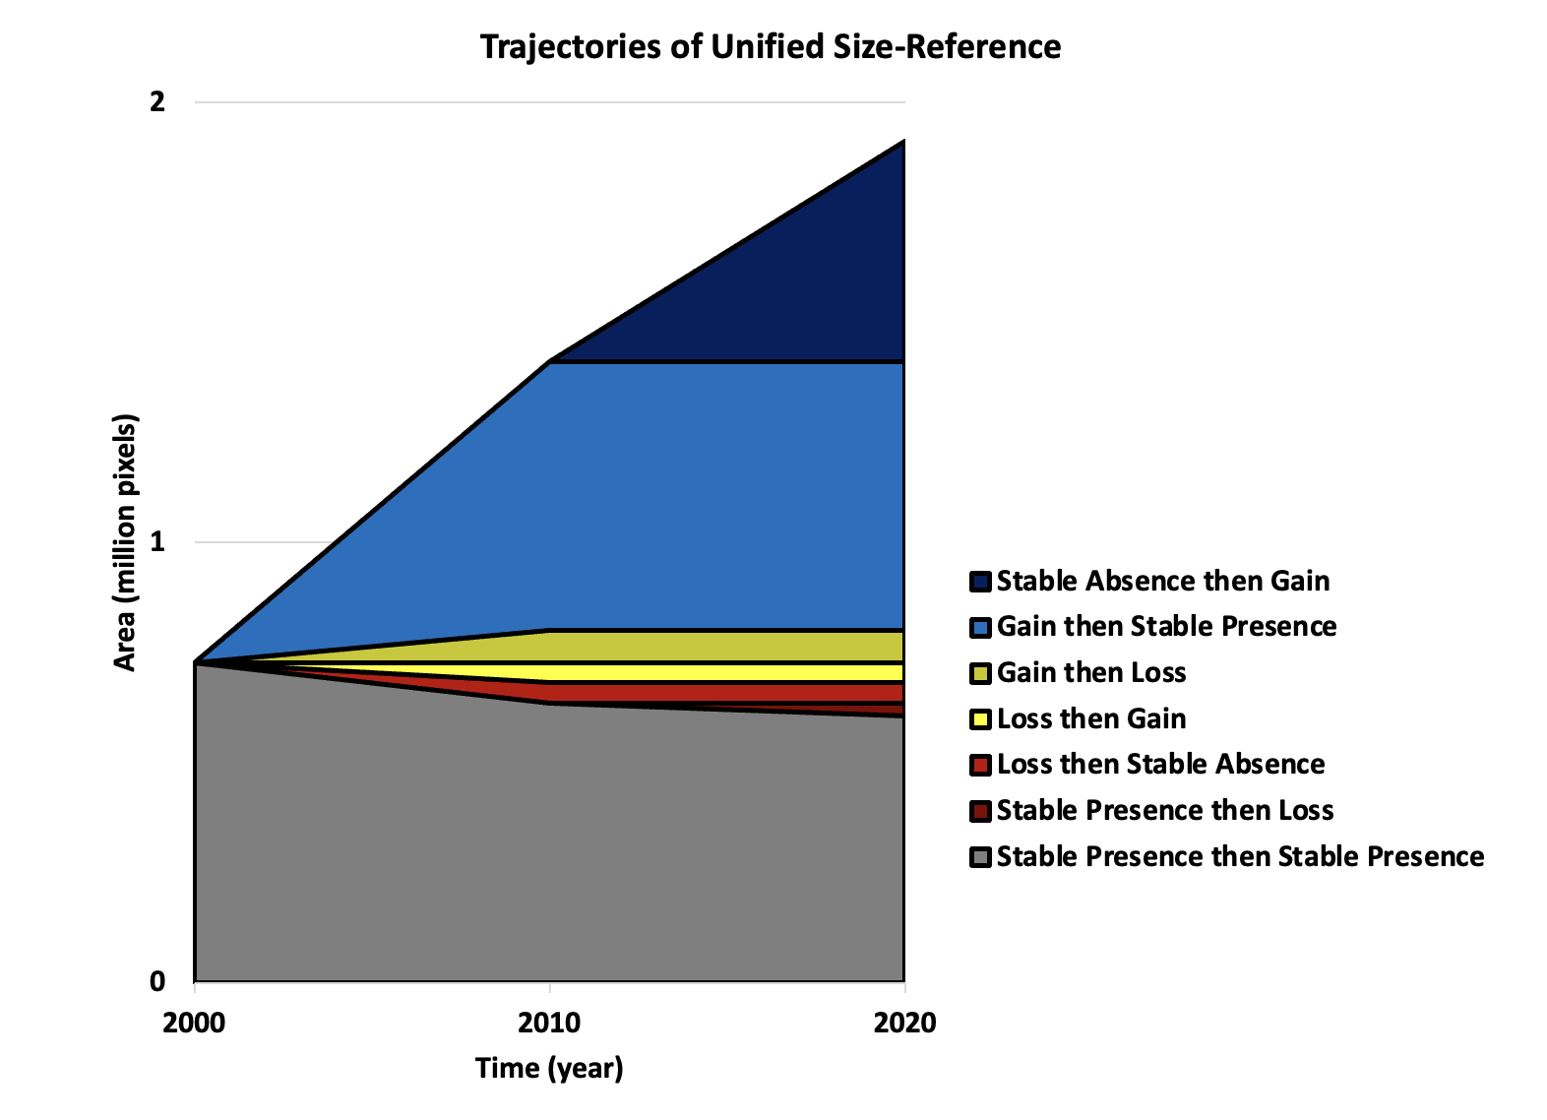
Trajectories of Unified Size (2000-2010-2020)
Simulation
Reference

Slide 17
Run4: DTC (dynamic) and Elevation (static)
Two Variables
Notes:
Addy

Slide 18
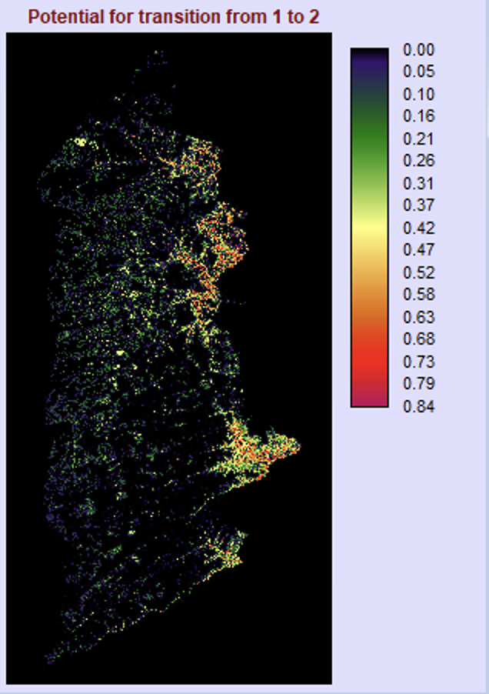
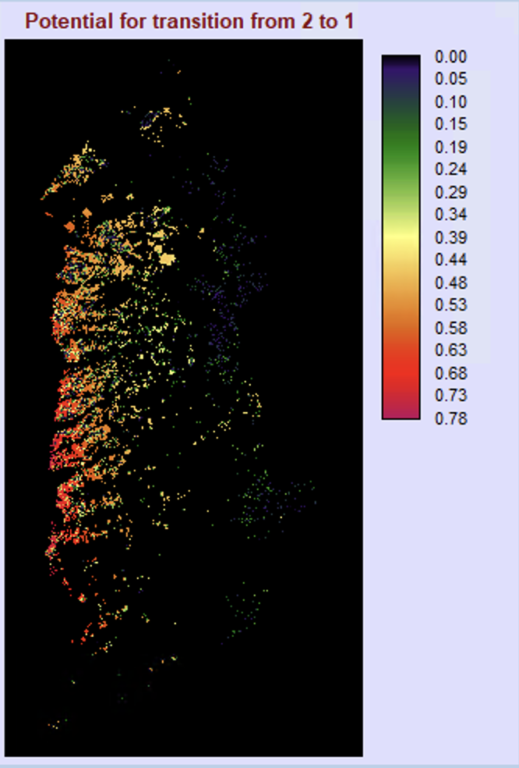
Transition Potential Maps for 2 stages for the 2 Variable run (DTC, elevation)
Notes:
Clio

Slide 19
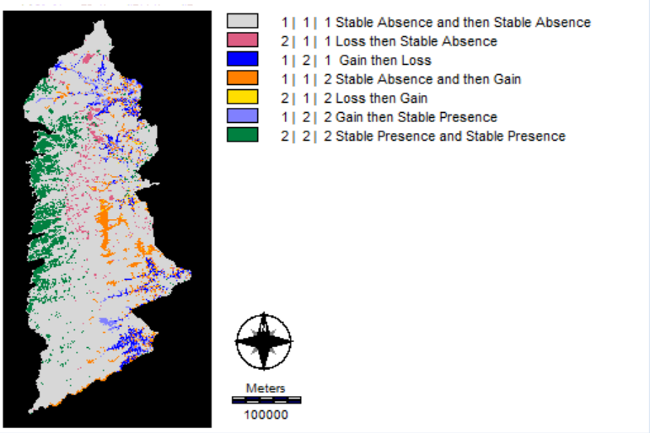
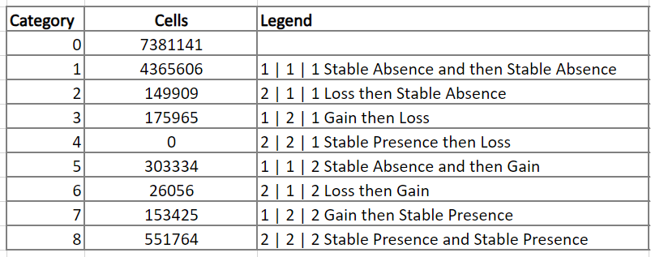
CROSSTAB – Two variables DTC (dynamic) & elevation
Simulate Change 2000 | 2010 | 2020
Reference Change 2000 | 2010 | 2020
Loss (2,3,4) : 325,874
Gain (5,6,7): 482,815
Loss (2,3,4) : 148,462
Gain (5,6,7): 1,155,290
Absence of Alternation in Simulation:
2 | 2 | 1 Stable Presence then Loss
Notes:
Addy

Slide 20
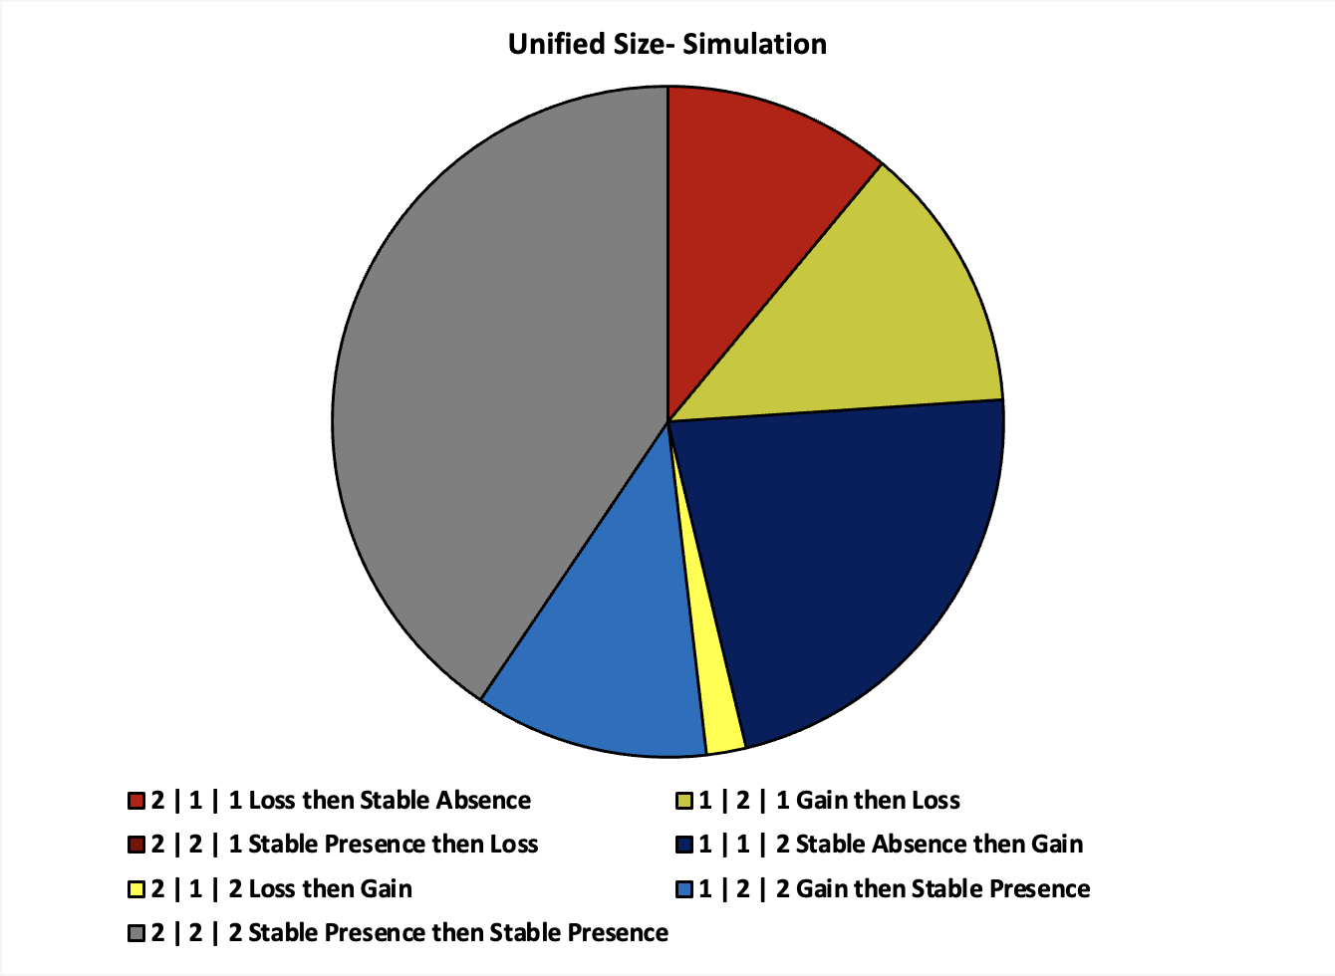
Trajectory of simulated change with 2 variables (2000-2010-2020)
Unified Size - Simulation
Unified Size - Reference

Slide 21
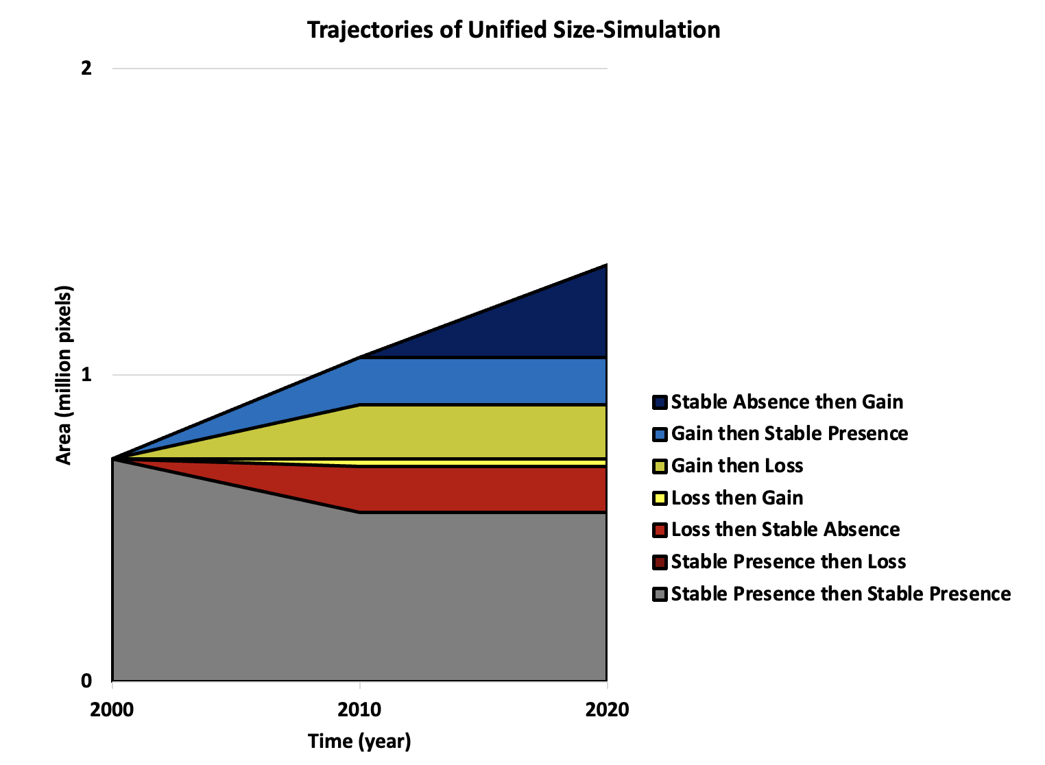
Trajectory of Unified Size (2000-2010-2020)
Simulation
Reference

Slide 22
Run5: DTC (dynamic), Elevation (static), and Slope (static)
Three Variables
Notes:
Addy

Slide 23
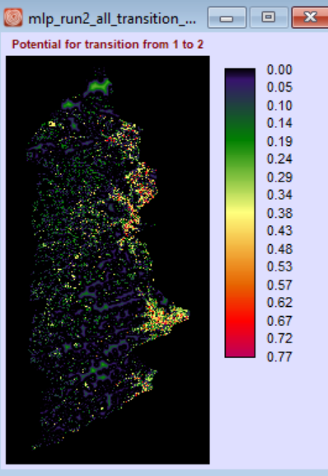
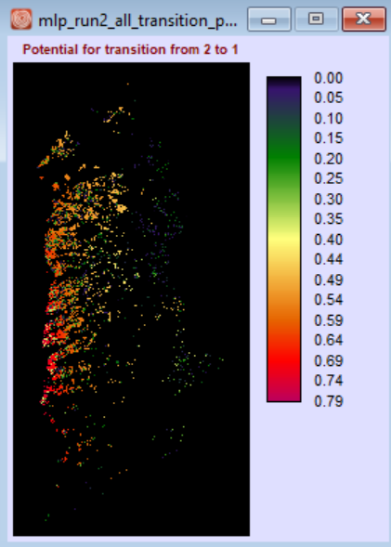
Transition Potential Maps for 2 stages for the 3 Variable run
(DTC, slope, elevation)
Notes:
Clio

Slide 24
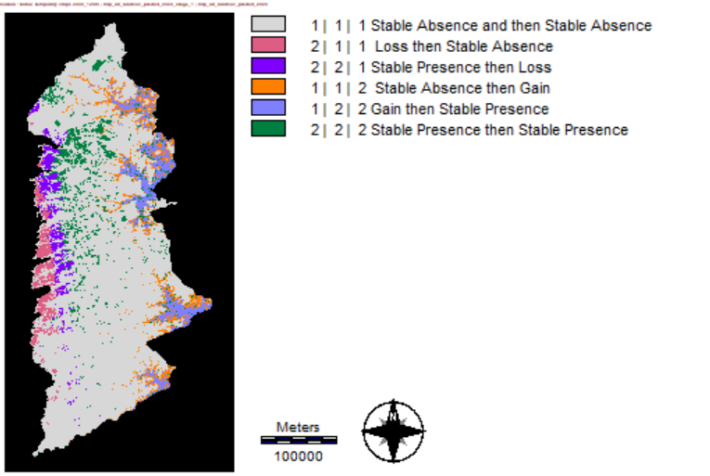
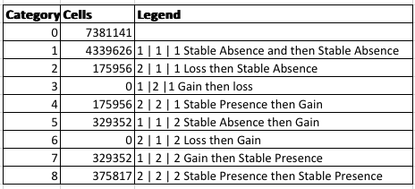
CROSSTAB of 3 variables - DTC (dynamic), Slope, Elevation
MLP Trajectory of Simulate Change 2000 | 2010 | 2020
Reference Change 2000 | 2010 | 2020
Loss (2,3,4) : 351,912
Gain (5,6,7): 658,704
Loss (2,3,4) : 148,462
Gain (5,6,7): 1,155,290
Absence of Alternation in Simulation:
1 | 2 | 1 Gain then Loss
2 | 1 | 2 Loss then Gain
Notes:
Clio
Once that pixel changes, there is no opportunity for it to change back

Slide 25
REGRESS
We created a regress plot for each variable of each run to see how adding variables would impact the allocation of pixels.
We compared each variable to the transition potential map from 1(absence) to 2(presence).

Slide 26
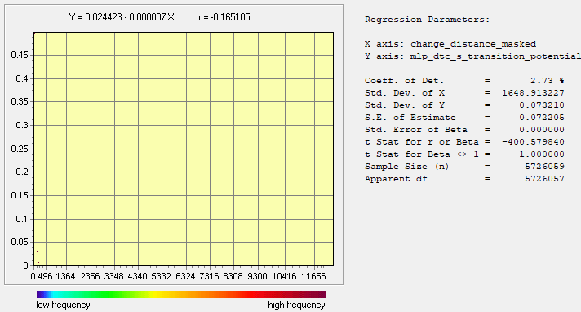
Run1: 1 variable(Independent) vs Transition Potential from 1 to 2(Dependent)
Distance to Change (static)
There are very few pixels visible in this regress plot.
This is potentially because the transition potential values are so low that they blend into the x-axis.
The few pixels visible are around 500m or less from change and have higher transition potential values than those further away- (although the values are still very low) it is hard to definitively state the relationship with so few pixels visible.

Slide 27
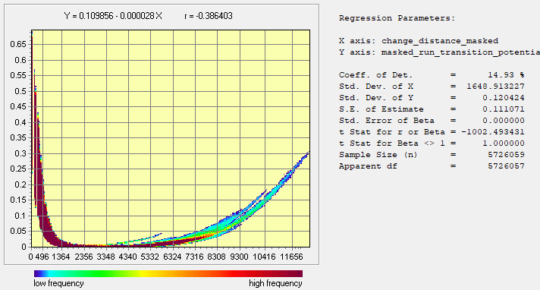
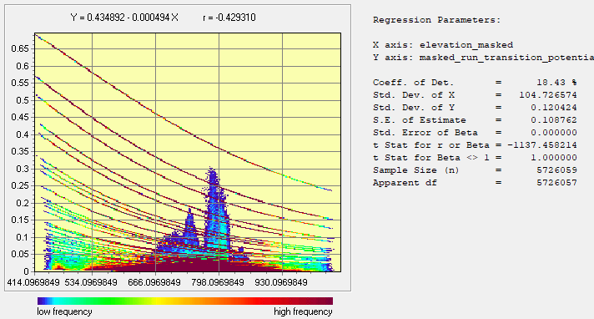
Run2: 2 variable(Independent) vs Transition Potential from 1 to 2(Dependent)
Distance to Change (static)
Areas closer to change have the highest transition potentials. There is a steep decline in transition potentials until around 1000m, followed by a period of nearly 0 transition potentials before a gradual increase around 5000m. This is likely due to the additional of elevation as a variable.
Elevation
There are a large number of pixels that have transition potential values that are less that 0.05.
There are a couple of peaks in transition potentials, the largest being at around 780 m. The majority of the pixels have low transition potential values around 0.5 or less.

Slide 28
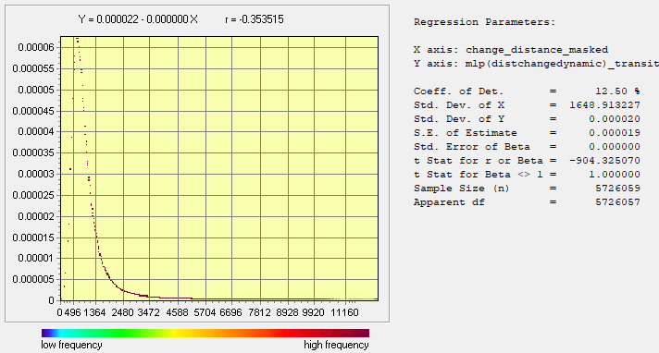
Run3: DTC(dynamic) as Independent vs Transition Potentials as Dependent
DTC (dynamic)
All the pixels in this plot have very low transition potential values— note that the y-axis ranges from 0.000005 to 0.00006.
Areas where DTC is closest to 0 appear to have very low transition potential values, but as DTC increases, the transition potential values increase rapidly and peak at about 500m before decreasing rapidly and remaining low.

Slide 29
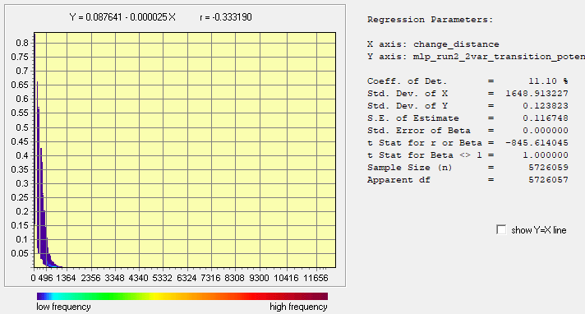
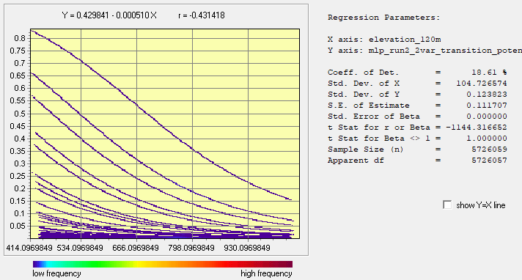
Run4: 2 Variables(Independent) vs Transition Potential from 1 to 2(Dependent)
Distance to Change (dynamic)
Areas closer to change tend to have higher transition potential values than those further away from change.
At around 500m the transition potential values approach 0.
Elevation
The transition potential values are higher at lower elevations and then decrease as elevation increases.

Slide 30
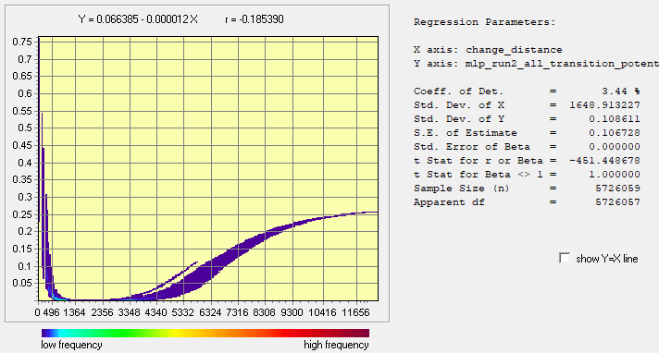
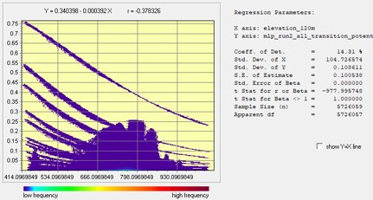
Run5: 3 Variables(Independent) vs Transition Potential from 1 to 2(Dependent)
Distance to Change(dynamic)
Closer areas, around <1364m to change have higher transition potential values. Around 4000m the transition potential values begin to steadily increase.
The steady increase in transition potential values after approximately 4000 meters is likely due to the addition of the slope variable.
Elevation
The transition potential values decrease as elevation increases.
The highest transition potentials occurred at lower elevations.
We believe the "blob" in the middle of the graph is likely due to the addition of elevation as a variable.

Slide 31
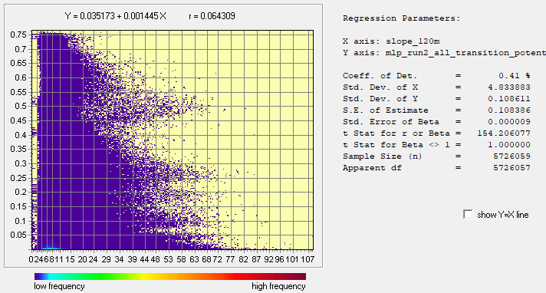
Run5: 3 Variables(Independent) vs Transition Potential from 1 to 2 (Dependent)
Slope
Predicted change is allocated to high transitions between 4-10m.​
There is less of a defined relationship between elevation and the transition potential map, so likely this variable has the least influence on the allocation of pixels.

Slide 32
Challenges

Slide 33
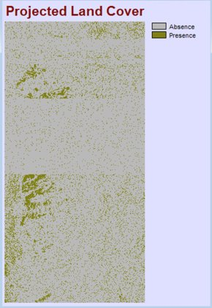
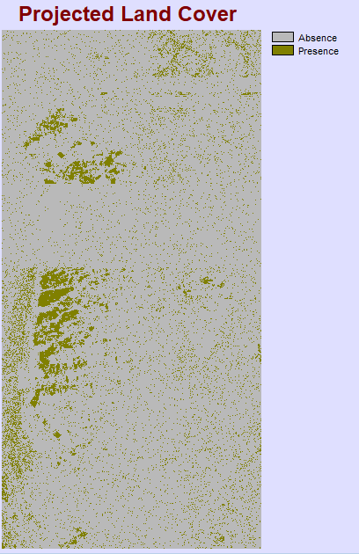
Striping
We initially ran logistic regression in LCM with only one variable: DTC as dynamic variable. This resulted in striping in prediction maps
In an email with Professor Pontius, he explained that this issue was caused by "the number of pixels of simulated change [being] fewer than the number of pixels that have the same transition potential value" and recommended that we add more variables.
This led us to adding two additional variables, elevation and slope, to our next runs.

Slide 34
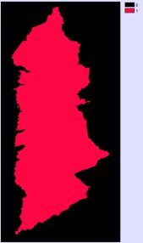
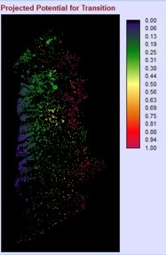
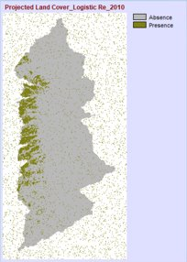
Simulated change in mask (Logistic Regression)
We added the three variables (DTC, slope, elevation), and added a mask of the area outside of the 9 municipalities as a constraint.
Despite the constraint however, the model was predicting change with no apparent pattern outside the study area – we are not sure why this is happening

Slide 35
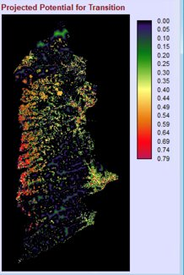
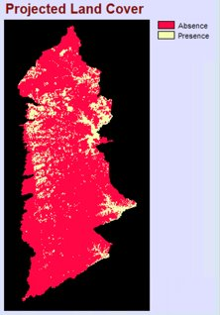
Logistic Regression
We initially tried the methodology with Logistic regression but due to the reasoning in the two previous slides – the striping and the prediction outside of the study area – we decided to do the subsequent runs using MLP and use those results instead.

Slide 36



MLP
Striping – Distance to Absence and Distance to Presence as Dynamic
Change in mask – Distance as Static, Distance to Absence, and Distance to Presence as Dynamic

Slide 37




Unexpected Error (DTC as Dynamic, Slope, Elevation)
Unexpected errors occurred when we tried different runs with the same variable in MLP. The result on the left we ran with DTC as Dynamic, Slope, and Elevation, which is Run5, but the results got pixels allocation out of the study area; after we restarted Terrest and ran again, the problem was solved.

Slide 38




Unexpected Error (DTC as Static, Elevation)

Slide 39
Conclusion

Slide 40
Summary of Findings
Runs with static variables will not result in alternation.
In the dynamic runs (Runs 3,4,5), with each added variable, a category is lost.
In Run 4, we lost 2 | 2 | 1 Stable Presence then Loss (although this was not an alternation category).
In Run 5 we lost both alternation categories, 1 | 2 | 1 Gain then Loss and 2 | 1 | 2 Loss then Gain
Our most successful run was Run 3 (DTC Dynamic) which was our only run that simulated alternation, however, it did exhibit banding issues.
TerrSet's LCM has some software issues that result in banding and pixel allocation error as seen in our challenges section of this PowerPoint.

Slide 41
Next Steps
We will compile a report on the issues we discovered during the analysis and send it to Tammy Woodard from Clark Labs - which will include striping and pixel allocation outside of the study area.
Although this goes beyond the scope of our project, it would be interesting to see if alternation can be achieved without the striping issue seen in Run3 (1 variable, DTC dynamic) using LCM.

Slide 42

Thank you!

